Slide 1
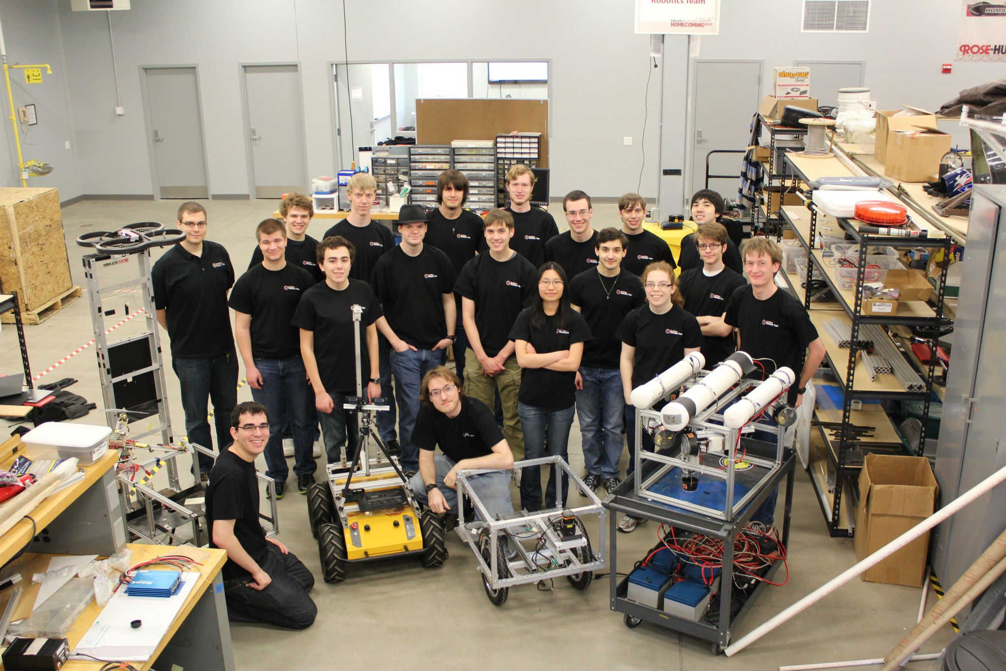
ROSE-HULMAN INSTITUTE OF TECHNOLOGY
ROBOTICS TEAM

Slide 2
Team’s PURPOSE
To allow engineering students the opportunity to learn and experience challenging robotic problems.
The Design Process
Teamwork
Network
Hands-on experience
Time management
Improve learned skills
Multidisciplinary
Debugging
Innovate
Fun

Slide 3
Team Structure
Advisors:
Dr. David C Mutchler (Computer Science)
Dr. David Fisher (Mechanical Engineering)
President: Allison Crump
Vice-President: Gustavo Romo
Secretary: Rain Dartt
Treasurer: Ben Griffith
Public Relations: Elena Chong
MATE
Air
Officers
Competition Teams
IGVC
Peter Heath
Software Systems
Andrew Tebbe
Hardware Systems
Michael Pauly
Alex Memering
Team Leaders
Battlebots
David Johnston

Slide 4
MATE
Marine Advance Technology Education (MATE) consists of an international underwater ROV student contest across the U.S, Canada, Scotland, Hong Kong, and Japan.
Competition Characteristics
Sophisticated missions
Critical Thinking
Teamwork
Weight distribution
ROV research

Slide 5
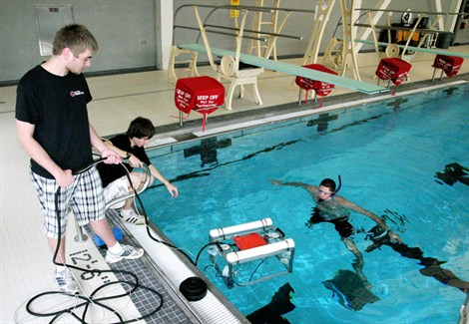
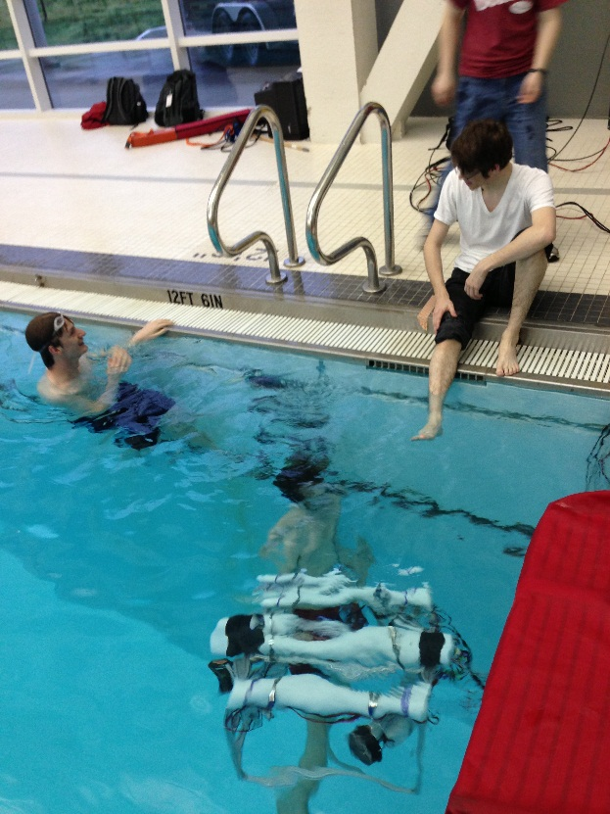
MATE Team Tasks
Design Process
Fabrication
of Parts
Water-proofing electronics
Electrical System Design
Write Control Software
Testing

Slide 6


Slide 7
Milestones for 2014 MATE
Fall
Select parts and components for new robot design
model new robot
Winter
complete fabrication
Continue software development
Spring
Test
Test some more
Go through design reviews
Begin fabrication
Begin software development
Attain missions
Testing
Qualifiers
Make it better for championships

Slide 8
IGVC
Sponsored by AUVSI, the Intelligent Ground Vehicle Competition (IGVC) consists of an international autonomous robotics challenge for undergraduate and graduate level students.
Competition Characteristics:
GPS waypoint navigation
Line detection
Efficient path planning
Teamwork and communication
Efficient power distribution
Extensive testing
Debugging
Obstacle avoidance

Slide 9
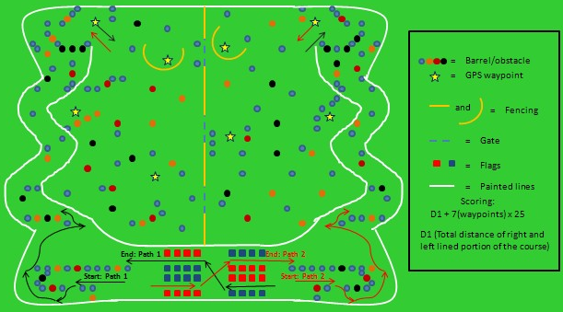
The IGVC Track

Slide 10
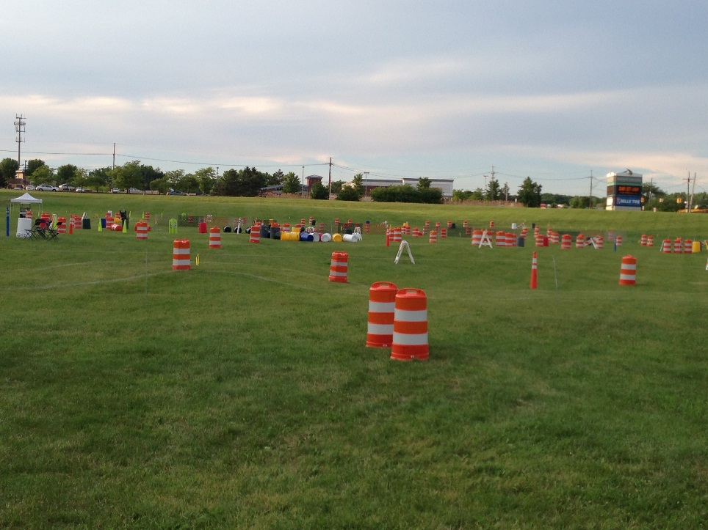
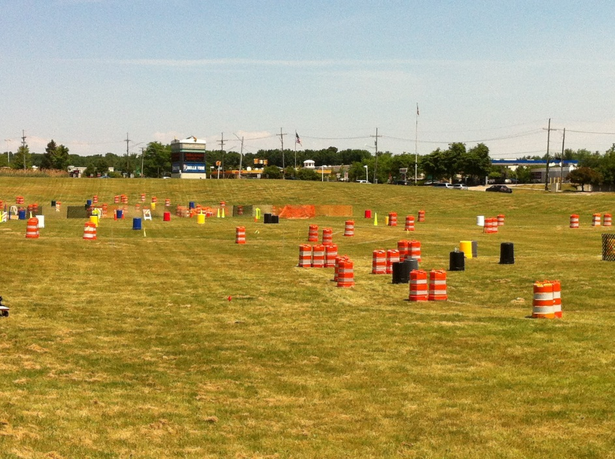
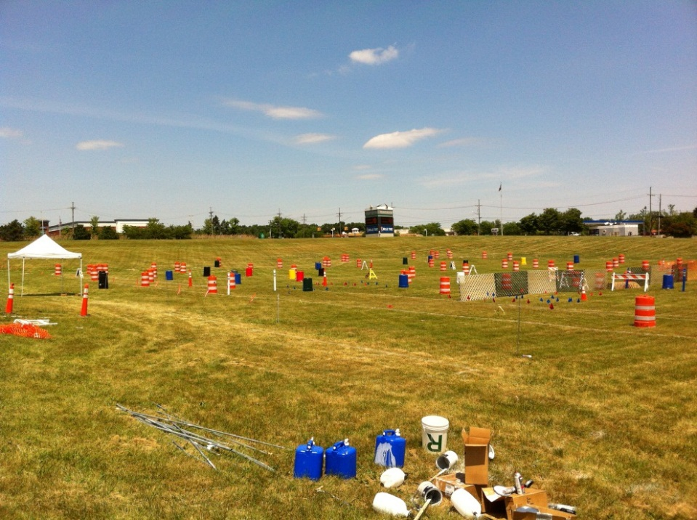
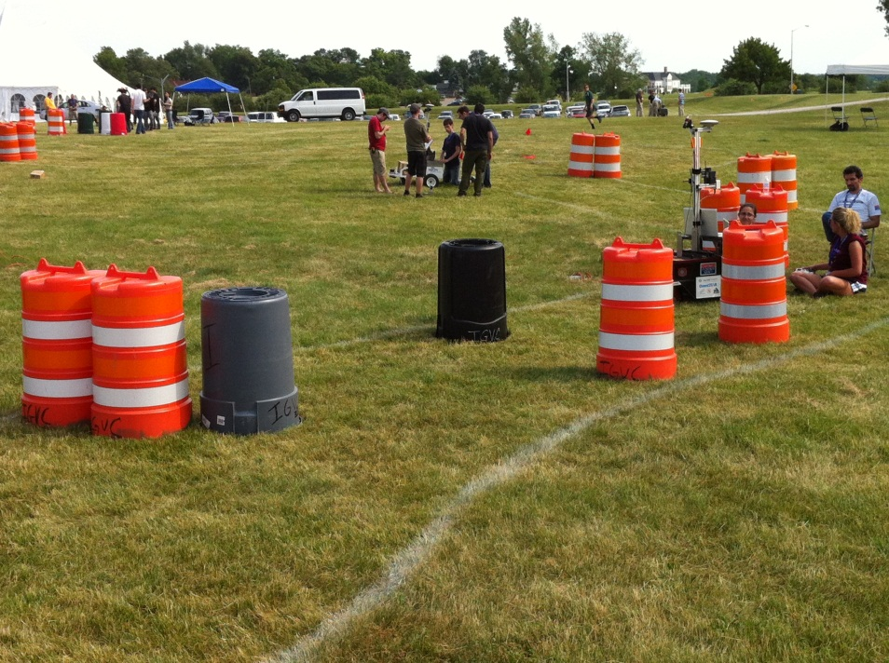
The IGVC Track

Slide 11
IGVC Team Organization – 2 teams
Hardware Systems
Michael Pauly (lead)
Mechanical Frame
Weight Distribution
Power Distribution
Electronic Wiring
Modeling
Machining
Software Systems
Andrew Tebbe(lead)
PIC Programing
Path Planning
Image Recognition
A.I. Implementation
Sensor Fusion
Testing, testing, and testing

Slide 12
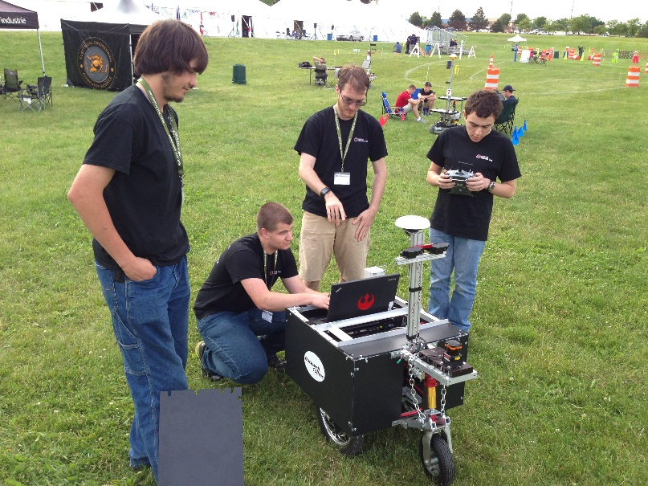
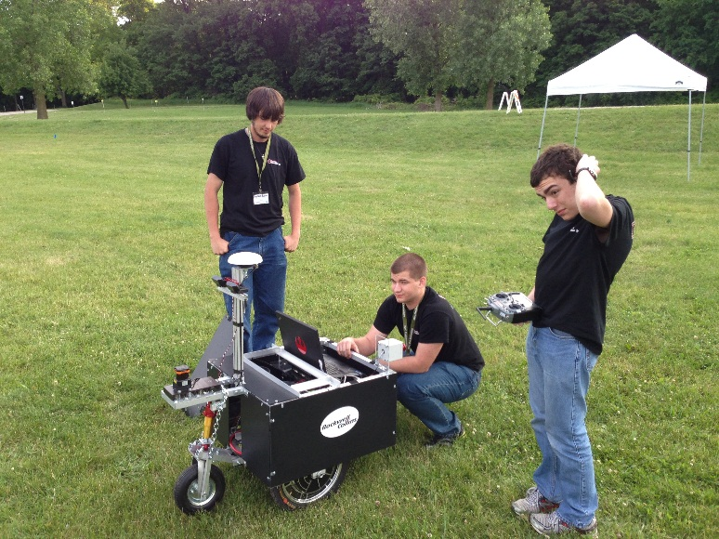
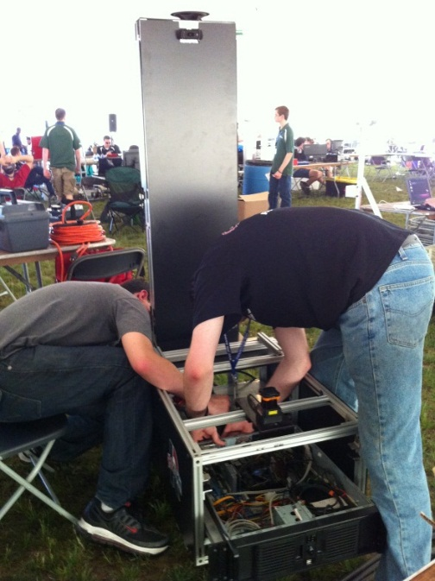
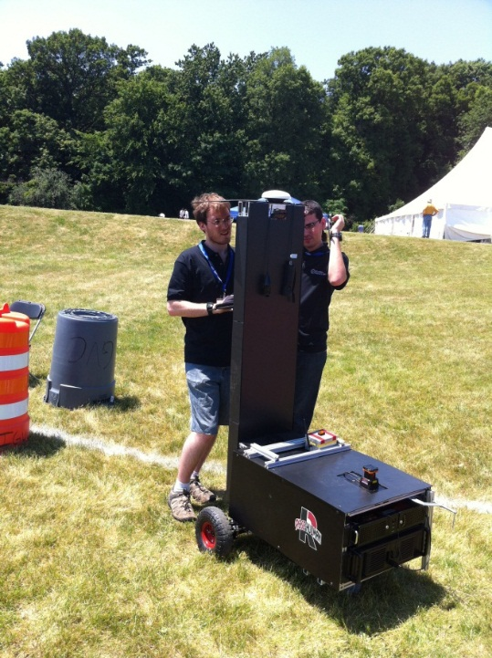
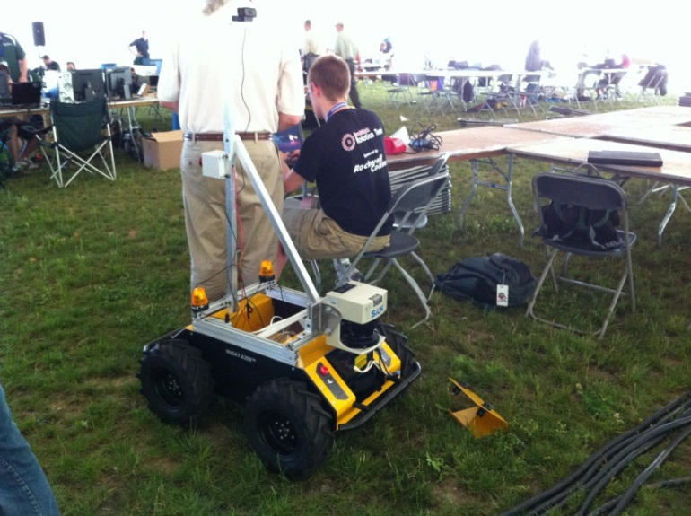
Past IGVC Pictures

Slide 13
Milestones for 2014 IGVC
Fall
Improve electronic components and sensors
Winter
Perform field tests as conditions permit
Spring
Simulate various competition environments and acquire field test data
Improve mechanical design
Tune and debug sensors and architecture as needed
Submit entry to IGVC
Write final report
Go through design reviews with faculty members
Focus on improving software architecture
Begin testing and deployment in field
270 days until IGVC 2014!!
June 6, 2014 at Oakland University

Slide 14
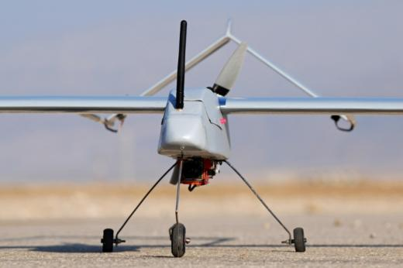
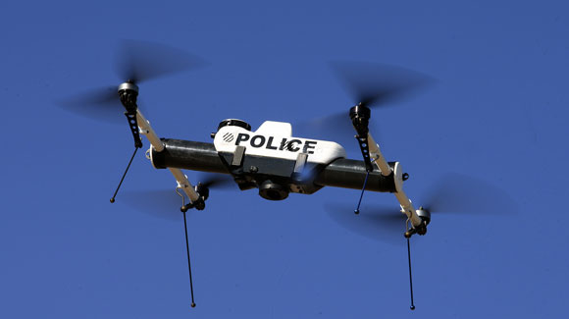
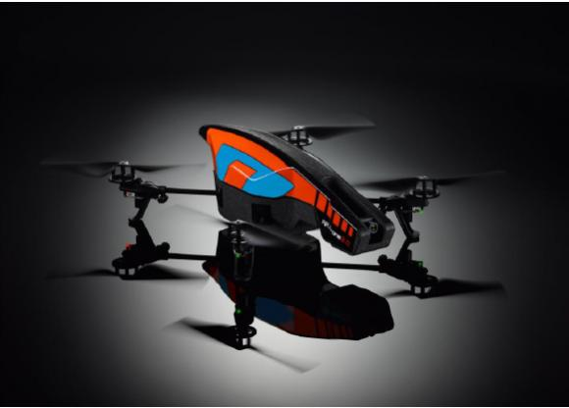
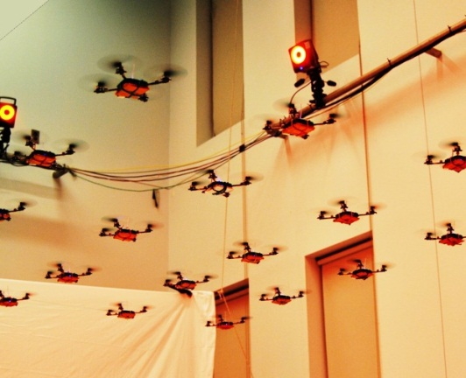
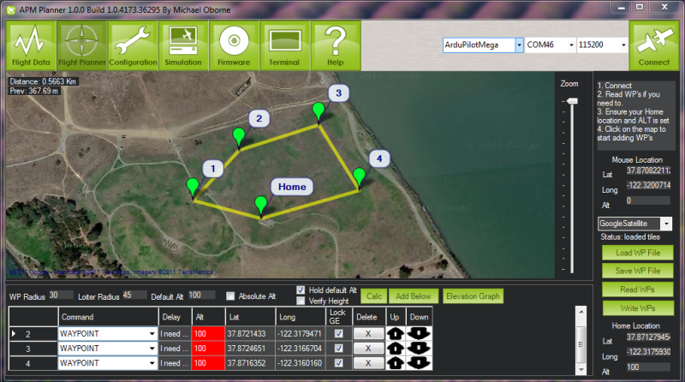
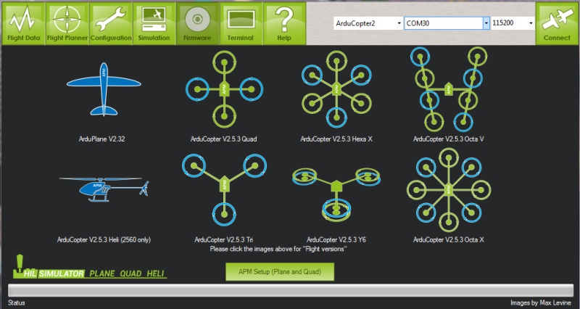
Aerial Robotics
Revive the origins of RHRT
Get students involved in the growing field of aerial robotics
Compete in robotics competitions
Have fun and peruse aerial and robotic hobbies

Slide 15


Design Requirements
Easy to repair
Durable and sturdy
Under budget
Maneuverable

Slide 16
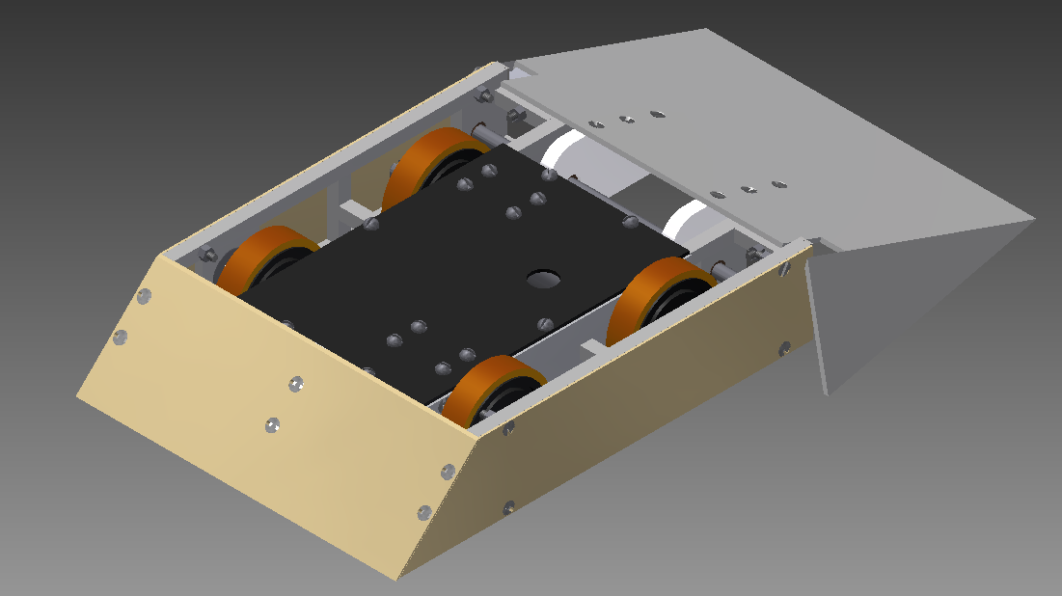
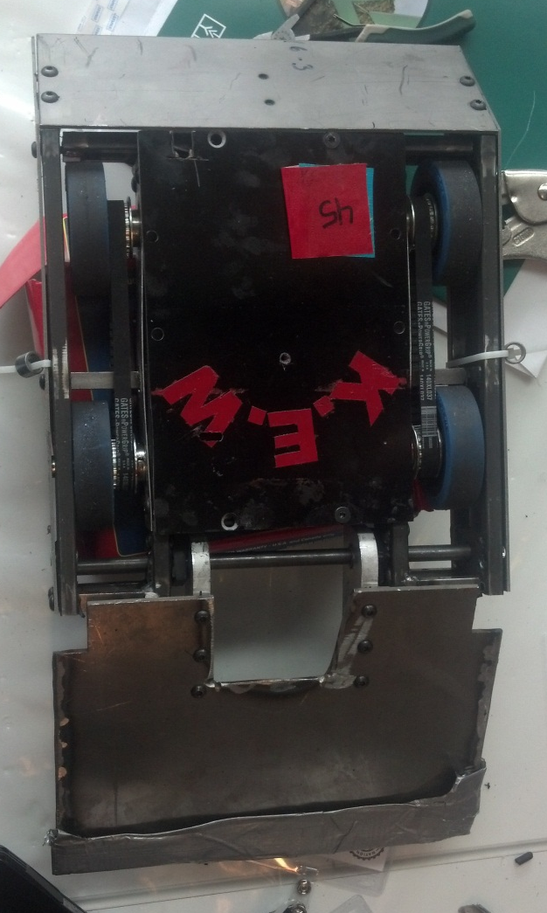
Past Design

Slide 17
Milestones for 2014 Battlebots
Fall
Obtain funding
Winter
Test and debug 3lbers
Spring
Test and debug 15lber
Design and build 3lb powered weapon ‘bots
Improve driving skills with 3lbers
Build 15lb ‘bot
Redesign 15lb ‘bot
Compete in regional competitions with 3lbers
Finalize design report
Compete in Regional NRL competition
Compete in NRL Nationals
250 days until NRL Nationals!!
May 16-17 2014 at Baldwin Wallace College

Slide 18
General Plans for the Year
Organize new working space at Branam Innovation Center (B.I.C.)
New students encouraged to take the free Udacity online courses to learn about A.I. implementation, localization, path planning, etc.
All sub-teams will start with new robotics platforms to improve design, resolve problems, and become more competitive.
Allow students to gain a broader hands-on experience on robotics by making the teams slightly more multidisciplinary.
To network with other universities, robotic companies, and the AUVSI organization.
To gain sufficient teamwork and acquire design techniques.
Continue sponsorship support and gain additional support for rising sub-teams.
Members encouraged to take Dr. Mutchler’s CSSE 290 – Software Challenges in Robotics

Slide 19
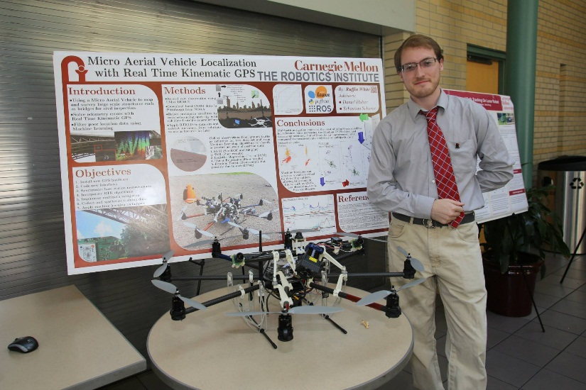





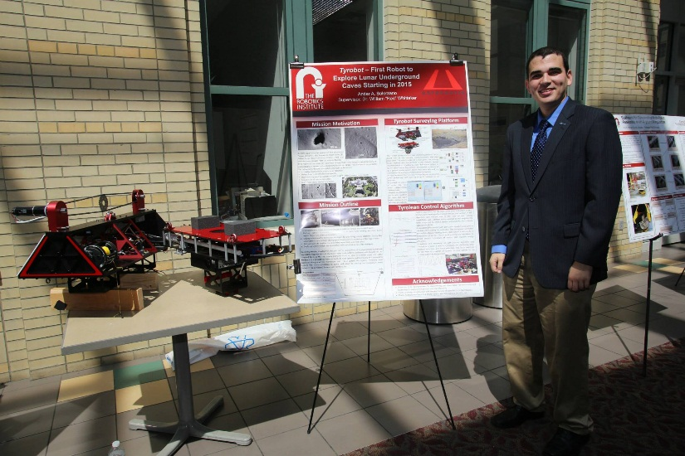





Past Members Today and Tomorrow

Slide 20






Team Acknowledgements
Partner Sponsor
Other Sponsors

